Slide 1

Database Management Systems Cornerstone Project
Final Review (Review I & II)
HOSPITAL MANAGEMENT SYSTEM
Presented by
T. NANDINI-25B11AIC11
k. SAI ADITYA-26B11AI127
I. KARTHIK-26B11AI045
Department of Artificial Intelligence & Machine Learning
SUBMITTED TO:
FACULTY NAME: V.G L.NARSAMBA

Slide 2
Presentation outline:
Finalize title, objectives & problem statement
Abstract
Identify entities & attributes
Design ER diagram & relationships
Prepare relational database schema
Define Primary & Foreign Keys
Create GitHub repo & responsibilities
Database creation & constraints
Insert sample data:
DDL, DML & DQL operations
CRUD operations & SQL queries
Data integrity & validation
Project documentation
Demonstrate & present database
Conclusion

Slide 3
DESIGN:
Problem Statement:
Managing patient information, doctors, appointments, treatments, prescriptions, billing, and hospital records manually can be difficult and time-consuming. Manual record management may lead to duplicate data, incorrect information, difficulty in retrieving patient records, appointment conflicts, and errors in billing and treatment details.
Therefore, a Hospital Management System is developed using a relational database to provide a centralized system for storing, organizing, and managing hospital-related information efficiently and accurately.

Slide 4
Objectives:
To manage patient information efficiently.
To maintain doctor and department details.
To manage patient appointments.
To maintain admission and discharge records.
To store diagnosis and treatment information.
To manage prescription and medicine details.
To maintain billing and payment information.
To reduce data redundancy and manual errors.
To provide quick access to hospital records.
To improve the efficiency of hospital management.

Slide 5
Abstract
The Hospital Management System is a database-based application designed to manage and organize important hospital information in a centralized manner. The system maintains records of patients, doctors, departments, appointments, admissions, treatments, prescriptions, medicines, and bills.
The system uses a relational database where different tables are connected through Primary Keys and Foreign Keys. SQL operations such as DDL, DML, DQL, CRUD operations, joins, aggregate functions, and constraints can be used to manage and retrieve hospital information.
The main purpose of the system is to reduce manual work, avoid data duplication, maintain data integrity, and provide fast access to accurate hospital records. The database can be further extended with features such as online appointments, automated notifications, electronic medical records, and analytics.

Slide 6
ENTITIES&ATTRIBUTES:
No. | Entity | Attributes
1 | Patient | Patient_ID, Name, Gender, Date_of_Birth, Phone, Address
2 | Department | Department_ID, Department_Name, Location
3 | Doctor | Doctor_ID, Doctor_Name, Specialization, Phone, Department_ID
4 | Appointment | Appointment_ID, Patient_ID, Doctor_ID, Appointment_Date, Appointment_Time, Status
5 | Admission | Admission_ID, Patient_ID, Room_No, Admission_Date, Discharge_Date
6 | Treatment | Treatment_ID, Patient_ID, Doctor_ID, Diagnosis, Treatment_Date, Description
7 | Prescription | Prescription_ID, Patient_ID, Doctor_ID, Prescription_Date
8 | Medicine | Medicine_ID, Medicine_Name, Price, Stock
9 | Prescription_Item | Prescription_Item_ID, Prescription_ID, Medicine_ID, Quantity, Dosage
10 | Bill | Bill_ID, Patient_ID, Bill_Date, Total_Amount, Payment_Status

Slide 7
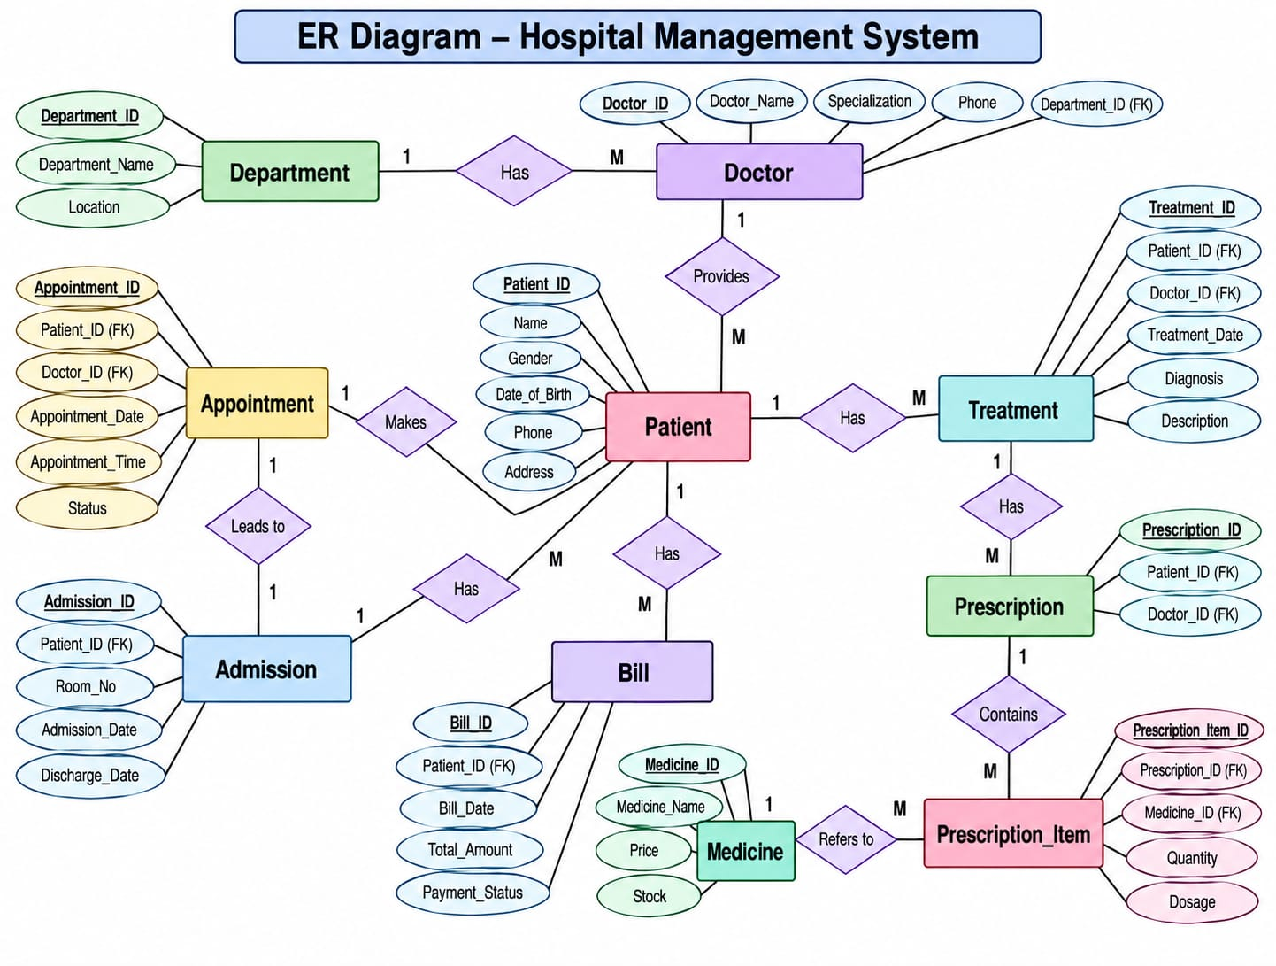

Slide 8
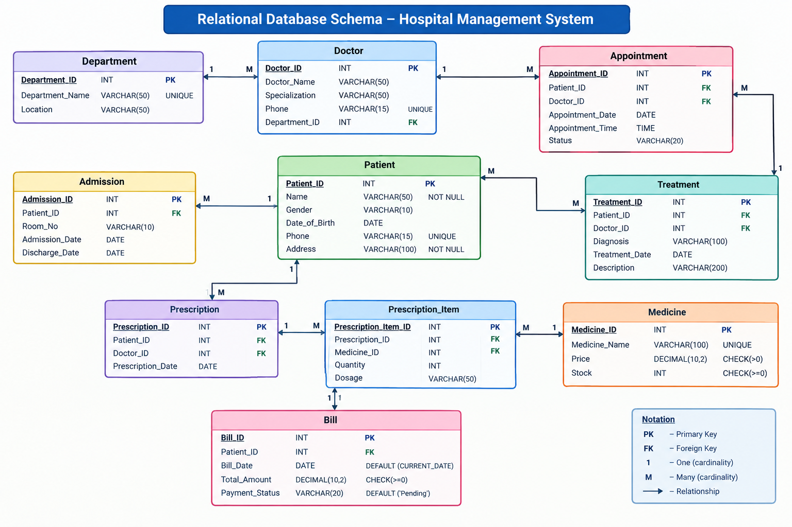

Slide 9
PRIMARY&FOREIGN KEYS:
Table | Primary Key | Foreign Key
Patient | Patient_ID | —
Department | Department_ID | —
Doctor | Doctor_ID | Department_ID
Appointment | Appointment_ID | Patient_ID, Doctor_ID
Admission | Admission_ID | Patient_ID
 | Treatment_ID | Patient_ID, Doctor_ID
Prescription | Prescription_ID | Patient_ID, Doctor_ID
Medicine | Medicine_ID | —
Prescription_Item | Prescription_Item_ID | Prescription_ID, Medicine_ID
Bill | Bill_ID | Patient_ID

Slide 10
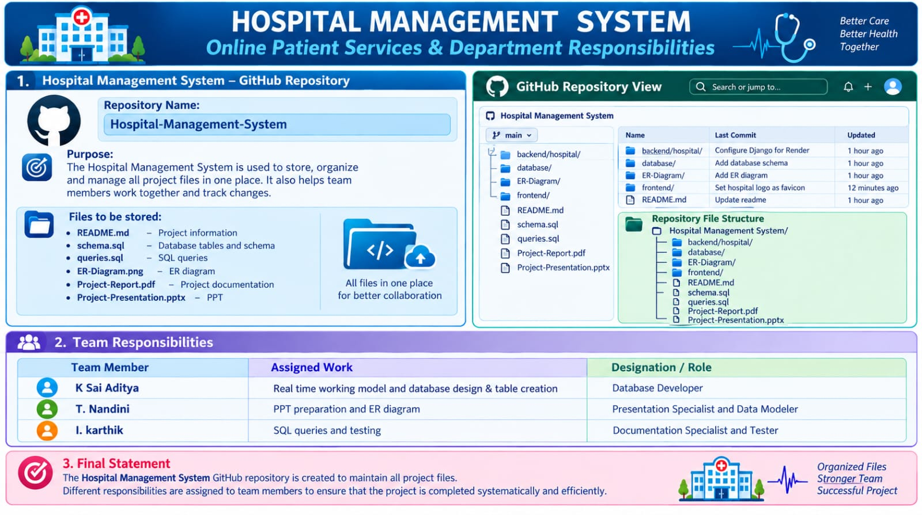

Slide 11
DATABASE&CONSTRAINTS:
Create Database
CREATE DATABASE Hospital_Management_System;
Patient Table
CREATE TABLE Patient (
Patient_ID INT PRIMARY KEY,
Name VARCHAR(50) NOT NULL,
Gender VARCHAR(10),
Date_of_Birth DATE,
Phone VARCHAR(15) UNIQUE,
Address VARCHAR(100) NOT NULL
);

Slide 12
Department Table
CREATE TABLE Department (
Department_ID INT PRIMARY KEY,
Department_Name VARCHAR(50) NOT NULL UNIQUE,
Location VARCHAR(50)
);
Doctor Table
CREATE TABLE Doctor (
Doctor_ID INT PRIMARY KEY,
Doctor_Name VARCHAR(50) NOT NULL,
Specialization VARCHAR(50) NOT NULL,
Phone VARCHAR(15) UNIQUE,
Department_ID INT,
FOREIGN KEY (Department_ID)
REFERENCES Department(Department_ID)
);

Slide 13
Appointment Table
CREATE TABLE Appointment (
Appointment_ID INT PRIMARY KEY,
Patient_ID INT NOT NULL,
Doctor_ID INT NOT NULL,
Appointment_Date DATE NOT NULL,
Appointment_Time TIME NOT NULL,
Status VARCHAR(20) DEFAULT 'Scheduled',
FOREIGN KEY (Patient_ID) REFERENCES Patient(Patient_ID),
FOREIGN KEY (Doctor_ID) REFERENCES Doctor(Doctor_ID)
);
Admission Table
CREATE TABLE Admission (
Admission_ID INT PRIMARY KEY,
Patient_ID INT NOT NULL,
Room_No VARCHAR(10) NOT NULL,
Admission_Date DATE NOT NULL,
Discharge_Date DATE,
FOREIGN KEY (Patient_ID) REFERENCES Patient(Patient_ID)
);

Slide 14
Treatment Table
CREATE TABLE Treatment (
Treatment_ID INT PRIMARY KEY,
Patient_ID INT NOT NULL,
Doctor_ID INT NOT NULL,
Diagnosis VARCHAR(100) NOT NULL,
Treatment_Date DATE NOT NULL,
Description VARCHAR(200),
FOREIGN KEY (Patient_ID) REFERENCES Patient(Patient_ID),
FOREIGN KEY (Doctor_ID) REFERENCES Doctor(Doctor_ID)
);
Prescription Table
CREATE TABLE Prescription (
Prescription_ID INT PRIMARY KEY,
Patient_ID INT NOT NULL,
Doctor_ID INT NOT NULL,
Prescription_Date DATE NOT NULL,
FOREIGN KEY (Patient_ID) REFERENCES Patient(Patient_ID),
FOREIGN KEY (Doctor_ID) REFERENCES Doctor(Doctor_ID)
);

Slide 15
Medicine Table
CREATE TABLE Medicine (
Medicine_ID INT PRIMARY KEY,
Medicine_Name VARCHAR(100) NOT NULL UNIQUE,
Price DECIMAL(10,2) CHECK (Price > 0),
Stock INT DEFAULT 0 CHECK (Stock >= 0)
);
Prescription_Item Table
CREATE TABLE Prescription_Item (
Prescription_Item_ID INT PRIMARY KEY,
Prescription_ID INT NOT NULL,
Medicine_ID INT NOT NULL,
Quantity INT CHECK (Quantity > 0),
Dosage VARCHAR(50),
FOREIGN KEY (Prescription_ID)
REFERENCES Prescription(Prescription_ID),
FOREIGN KEY (Medicine_ID)
REFERENCES Medicine(Medicine_ID)
);

Slide 16
Constraints Used
PRIMARY KEY → Uniquely identifies every record.
FOREIGN KEY → Connects related tables.
NOT NULL → Prevents important fields from being empty.
UNIQUE → Prevents duplicate phone numbers, department names, and medicine names.
CHECK → Ensures valid prices, quantities, and stock values.
DEFAULT → Provides automatic values such as appointment status and payment status

Slide 17
SAMPLE DATA INSERTION:
1. Patient
INSERT INTO Patient
(Patient_ID, Name, Gender, Date_of_Birth, Phone, Address)
VALUES
(1, 'Akshaya', 'Female', '2003-05-12', '9876543210', 'Hyderabad'),
(2, 'Rahul', 'Male', '2001-08-20', '9876543211', 'Vijayawada'),
(3, 'Priya', 'Female', '1999-11-15', '9876543212', 'Chennai'),
(4, 'Kiran', 'Male', '2000-02-10', '9876543213', 'Bangalore');
2. Department
INSERT INTO Department
(Department_ID, Department_Name, Location)
VALUES
(1, 'Cardiology', 'Block A'),
(2, 'Neurology', 'Block B'),
(3, 'General Medicine', 'Block C'),
(4, 'Orthopedics', 'Block D');

Slide 18
3. Doctor
INSERT INTO Doctor
(Doctor_ID, Doctor_Name, Specialization, Phone, Department_ID)
VALUES
(101, 'Dr. Ramesh', 'Cardiologist', '9000000001', 1),
(102, 'Dr. Sneha', 'Neurologist', '9000000002', 2),
(103, 'Dr. Arun', 'General Physician', '9000000003', 3),
(104, 'Dr. Meena', 'Orthopedic Specialist', '9000000004', 4);
4. Appointment
INSERT INTO Appointment
(Appointment_ID, Patient_ID, Doctor_ID, Appointment_Date,
Appointment_Time, Status)
VALUES
(1001, 1, 101, '2026-09-20', '10:00:00', 'Scheduled'),
(1002, 2, 102, '2026-09-20', '11:00:00', 'Scheduled'),
(1003, 3, 103, '2026-09-21', '09:30:00', 'Completed'),
(1004, 4, 104, '2026-09-21', '12:00:00', 'Scheduled');

Slide 19
5. Admission
INSERT INTO Admission
(Admission_ID, Patient_ID, Room_No, Admission_Date, Discharge_Date)
VALUES
(201, 1, 'A101', '2026-09-15', NULL),
(202, 2, 'B205', '2026-09-16', '2026-09-18'),
(203, 3, 'C102', '2026-09-17', NULL);
6. Treatment
INSERT INTO Treatment
(Treatment_ID, Patient_ID, Doctor_ID, Diagnosis,
Treatment_Date, Description)
VALUES
(301, 1, 101, 'Chest Pain', '2026-09-20',
'ECG and cardiac observation'),
(302, 2, 102, 'Migraine', '2026-09-20',
'Medication and rest'),
(303, 3, 103, 'Fever', '2026-09-21',
'General medication and observation');

Slide 20
7. Prescription
INSERT INTO Prescription
(Prescription_ID, Patient_ID, Doctor_ID, Prescription_Date)
VALUES
(401, 1, 101, '2026-09-20'),
(402, 2, 102, '2026-09-20'),
(403, 3, 103, '2026-09-21');

Slide 21
8. Medicine
INSERT INTO Medicine
(Medicine_ID, Medicine_Name, Price, Stock)
VALUES
(501, 'Paracetamol', 20.00, 100),
(502, 'Aspirin', 30.00, 80),
(503, 'Amoxicillin', 50.00, 60),
(504, 'Omeprazole', 40.00, 75);
9. Prescription_Item
INSERT INTO Prescription_Item
(Prescription_Item_ID, Prescription_ID, Medicine_ID, Quantity, Dosage)
VALUES
(601, 401, 502, 10, '1 tablet daily'),
(602, 402, 501, 6, '1 tablet twice daily'),
(603, 402, 504, 5, '1 tablet daily'),
(604, 403, 501, 6, '1 tablet twice daily');

Slide 22
; 10. Bill
INSERT INTO Bill
(Bill_ID, Patient_ID, Bill_Date, Total_Amount, Payment_Status)
VALUES
(701, 1, '2026-09-20', 5650.00, 'Paid'),
(702, 2, '2026-09-20', 2300.00, 'Pending'),
(703, 3, '2026-09-21', 1500.00, 'Paid');

Slide 23
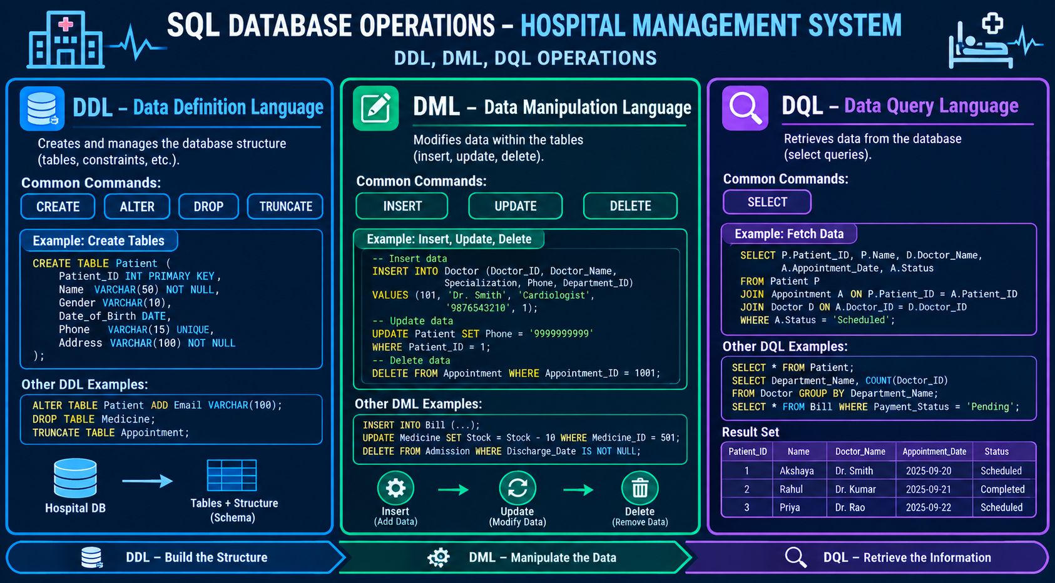
DDL,DML,DQL OPERATIONS:

Slide 24
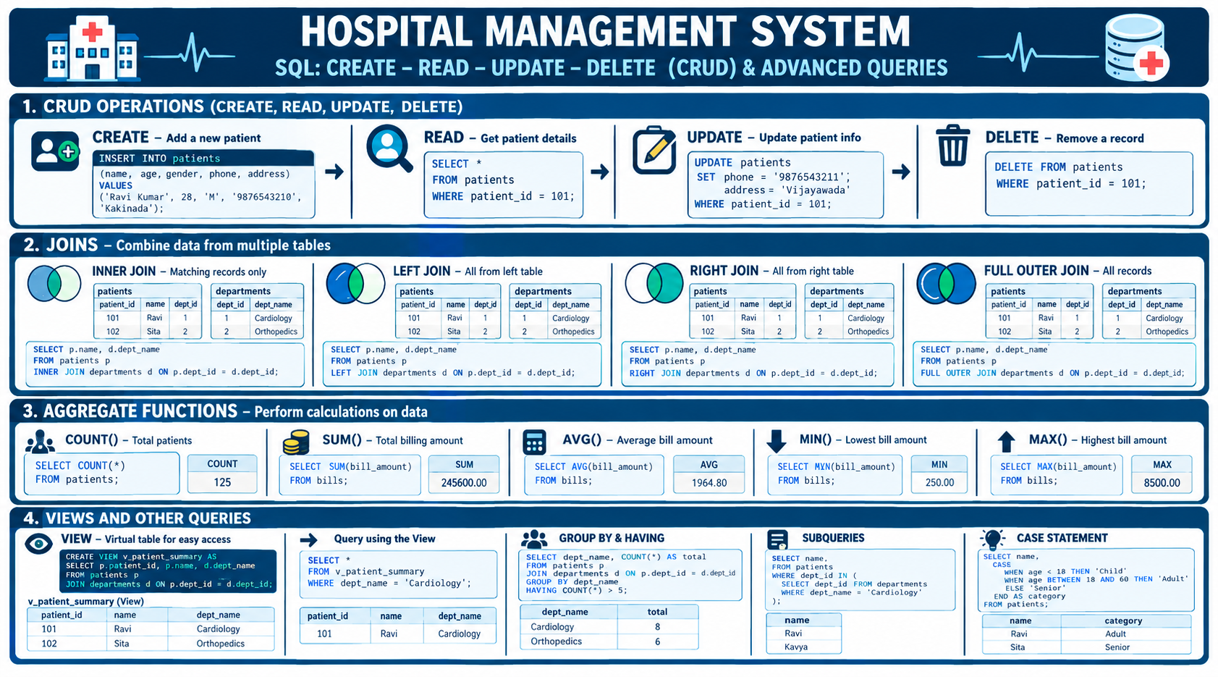
CRUD&SOL QUERIES:

Slide 25
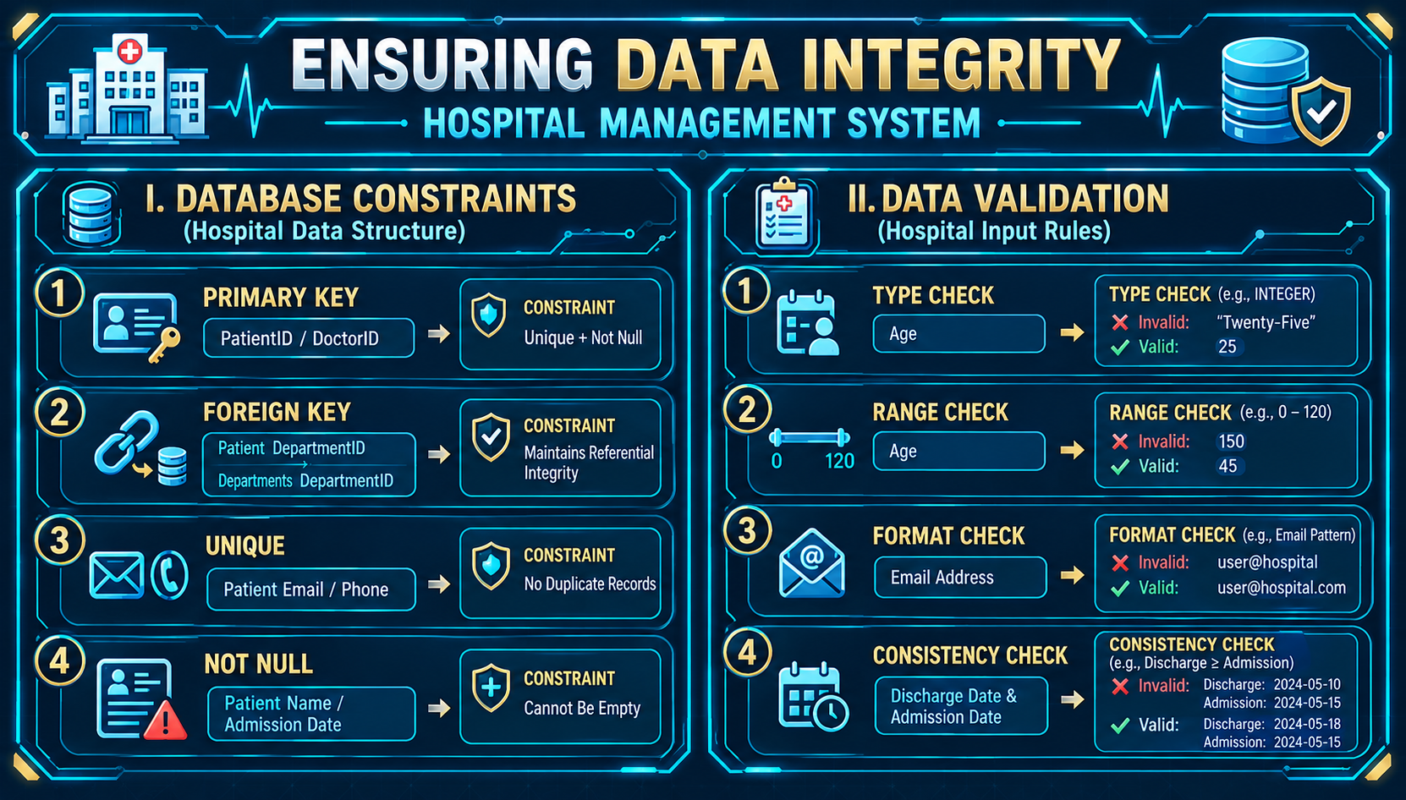
DATA INTEGRITY&VALIDATION:

Slide 26
PROJECT DOCUMENTATION:
Strengths
3NF Design: Reduces data redundancy.
Proper Relationships: Connects patients, doctors, departments, appointments, and treatments.
Keys & Constraints: Uses PK, FK, NOT NULL, UNIQUE, CHECK, and DEFAULT.
Quick Fixes
Maintain consistent patient and doctor attributes.
Add required foreign keys to related tables.
Use Prescription_Item to connect prescriptions and medicines.
Calculate derived values such as bills using SQL where needed.
Next Steps
DDL: Create tables with keys and constraints.
DML: Insert sample hospital data.
Integrity: Apply validation and referential integrity.
SQL Queries: Use JOIN, filtering, sorting, and aggregate functions.
Modules: Patient, Doctor, Appointment, Admission, Treatment, Medicine, and Billing.
Wrap-Up: Complete GitHub, team responsibilities, demonstration, future scope, and conclusion.

Slide 27
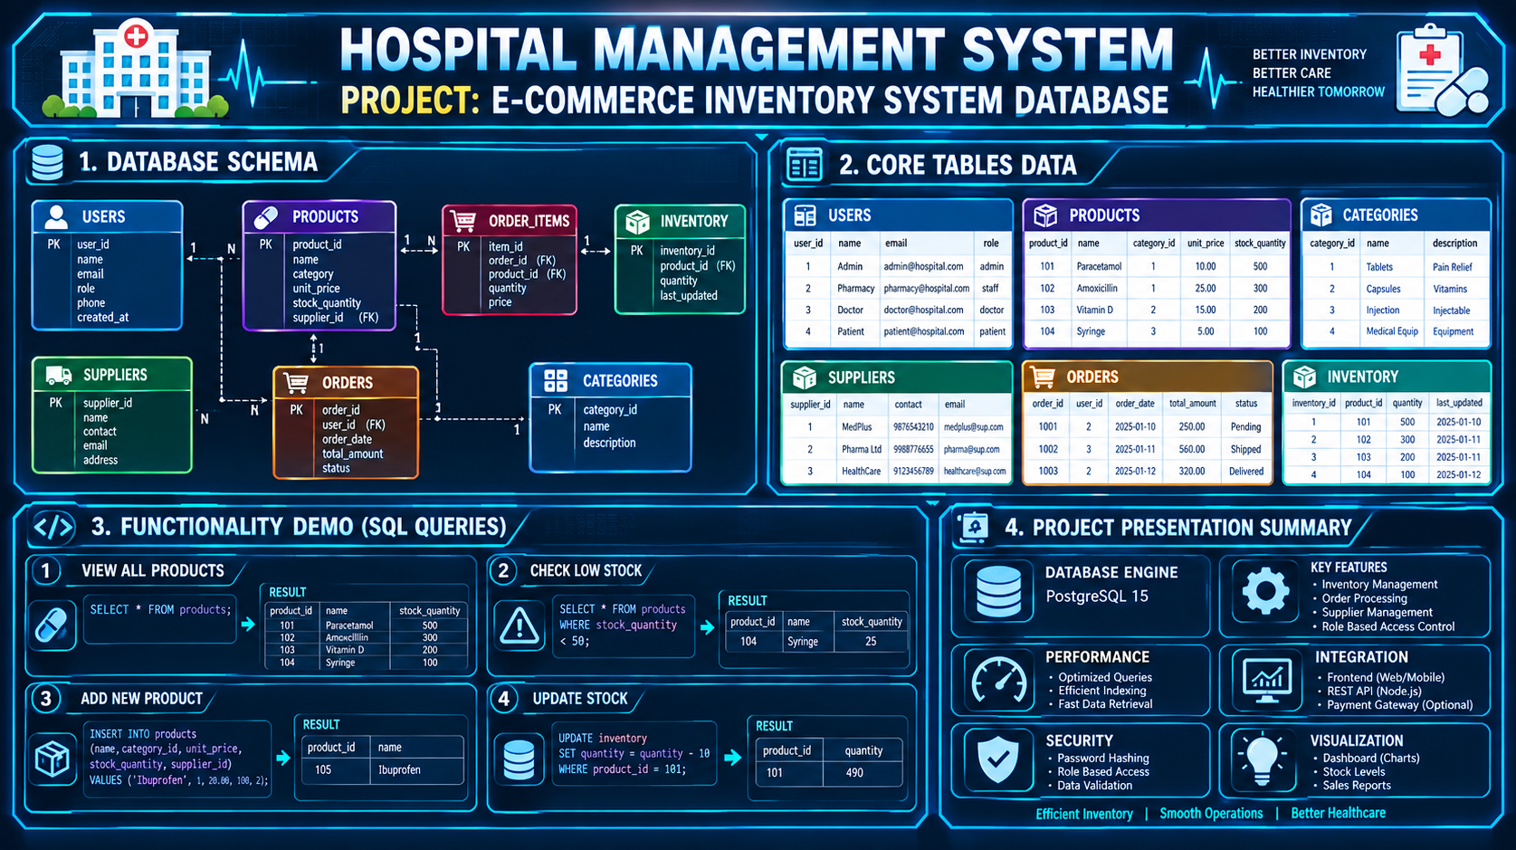
DEMONSTRATE&PRESENT:

Slide 28
CONCLUSION:
The Hospital Management System provides a structured and centralized approach to managing hospital information. The database connects patients, doctors, departments, appointments, admissions, treatments, prescriptions, medicines, and billing records through well-defined relationships.
The implementation demonstrates important DBMS concepts such as relational database design, primary keys, foreign keys, constraints, DDL, DML, DQL, CRUD operations, joins, aggregate functions, and data validation.
The system helps reduce data redundancy and manual errors while making hospital information easier to store, retrieve, and manage.

Slide 29
THANK YOU

